Slide 1
On-Premise Server Migration to Azure - Setup - AD Setup (Hybrid)

Slide 2
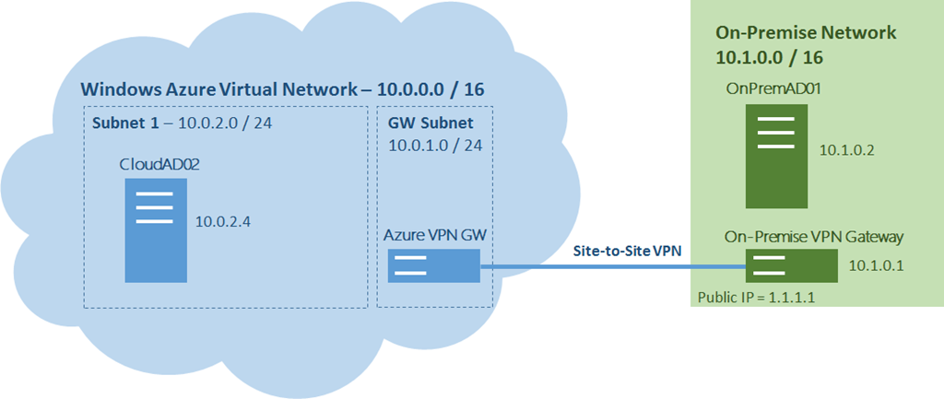
Diagrammatic Representation of AD Migration

Slide 3
Configuration Steps
Steps | Process
Configure On-Premise Active Directory Sites and Subnets | Manual(On-Premises)
Create site to site VPN & Register DNS Servers | Script/Portal
Promote Azure Vm as Additional DC | Script/Portal

Slide 4
Step-1: Configure On-premises AD sites and subnets

Slide 5
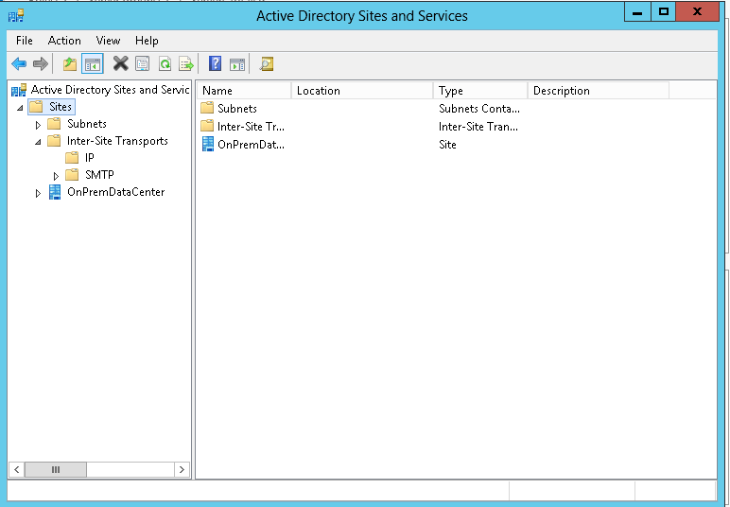
Step-1: Configure On-premises AD sites and subnets

Slide 6
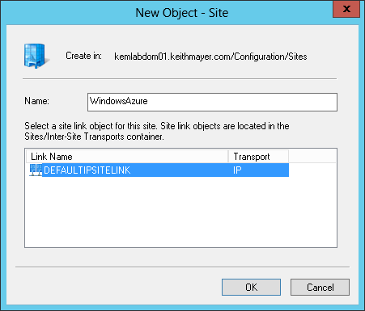
Configure On-premises AD sites and subnets
Create a new AD Site for Windows Azure.

Slide 7
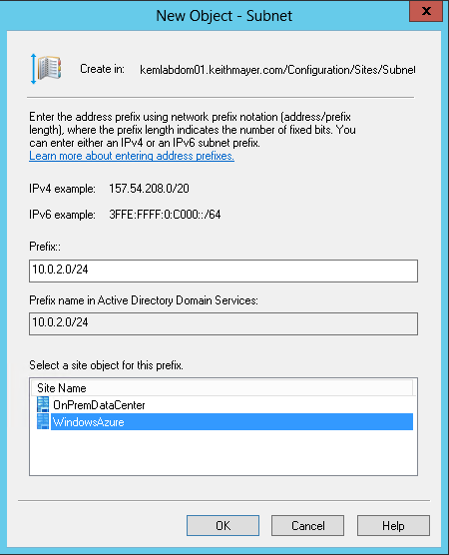
Configure On-premises AD sites and subnets
Create a new AD Subnet for Windows Azure.

Slide 8
Step-2: Create site to site VPN & Configure DNS Servers

Slide 9
Step-2: Create site to site VPN & Configure DNS Servers
Configuration:
Steps | Process
Create Azure Vnet | Script/Portal
Create Azure Vnet Gateway | Script/Portal
Create Local Network Gateway | Script/Portal
Exchange keys and establish connection between Vnet Gateway and Local Network Gateway | Script/Portal

Slide 10
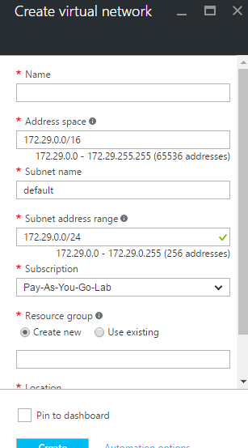
Step-2: Create site to site VPN & Configure DNS Servers
Create Azure Vnet
Register DNS servers of On-premises to created Azure Vnet.

Slide 11
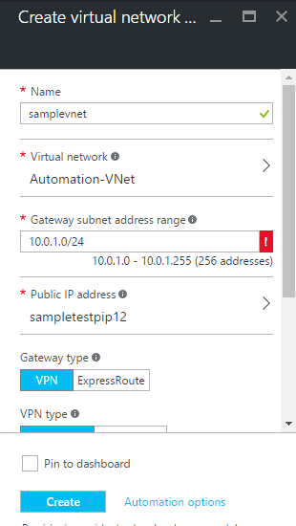
Step-2: Create site to site VPN & Configure DNS Servers
Create Azure Vnet Gateway

Slide 12
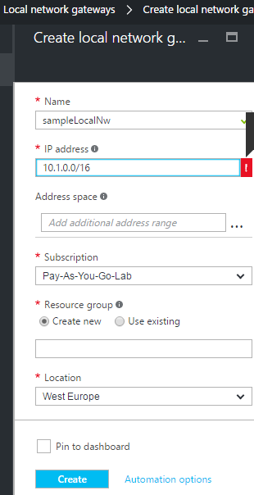
Step-2: Create site to site VPN & Configure DNS Servers
Create Local Network Gateway

Slide 13
Step-3: Promote Azure Vm as Additional DC

Slide 14
Step-3: Promote Azure Vm as Additional DC
Steps | Process
Create Azure VM in Created Vnet | Script/Portal
Join this VM to On-premises Domain as member server | Script/Portal
Promote Azure VM as Additional DC | Script/Portal

Slide 15
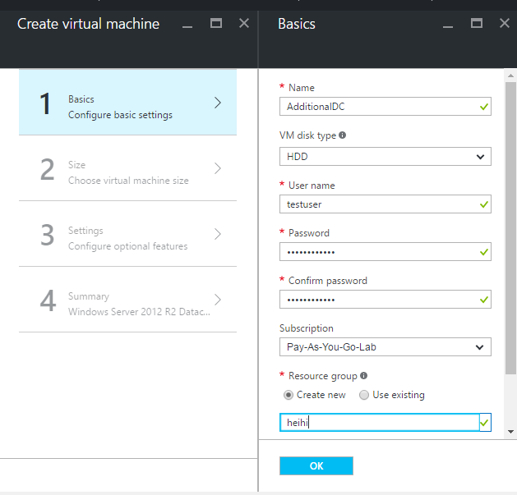
Step-3: Promote Azure Vm as Additional DC
Create AzureVM

Slide 16
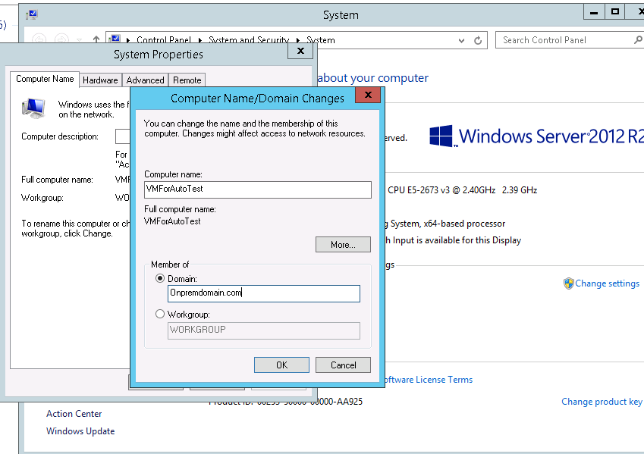
Step-3: Promote Azure VM as Additional DC
Join this VM to On-premises Domain as member server

Slide 17
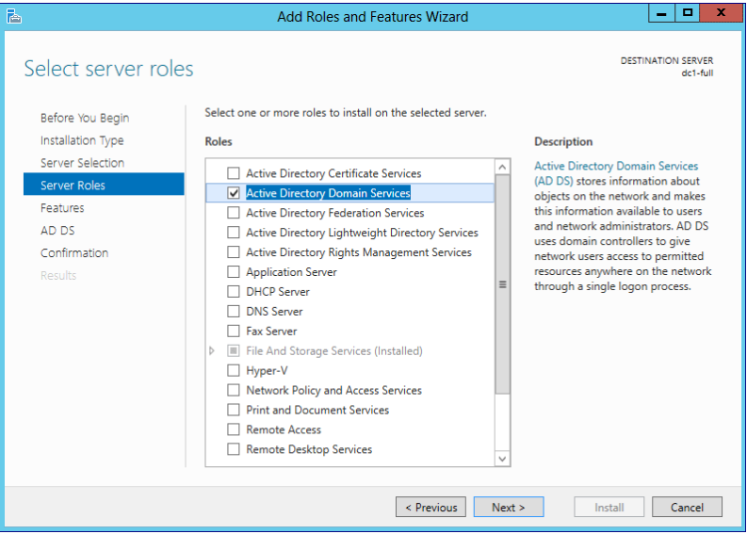
Step-3: Promote Azure VM as Additional DC
Promote Azure VM as Additional DC

Slide 18
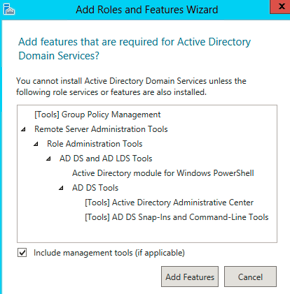
Step-3: Promote Azure VM as Additional DC

Slide 19
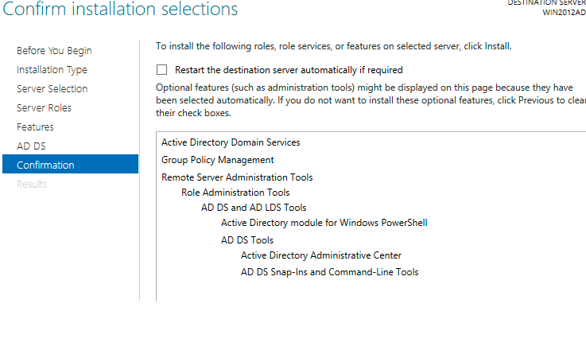
Step-3: Promote Azure VM as Additional DC

Slide 20
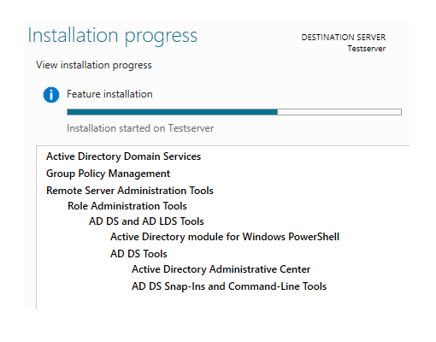
Step-3: Promote Azure VM as Additional DC

Slide 21
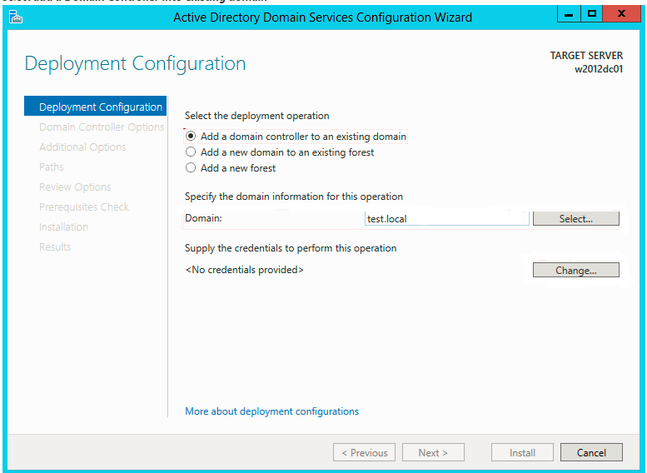
Step-3: Promote Azure VM as Additional DC

Slide 22
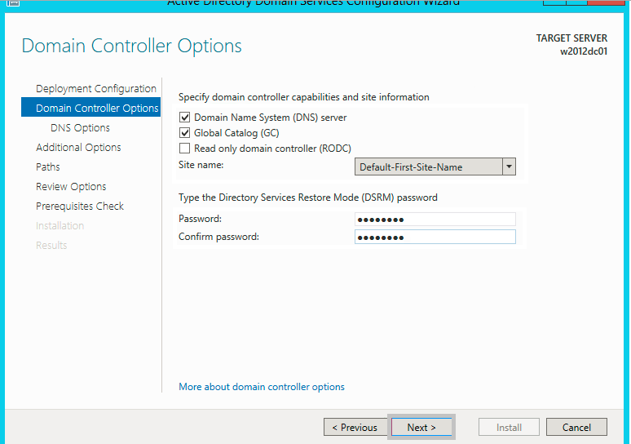
Step-3: Promote Azure VM as Additional DC

Slide 23
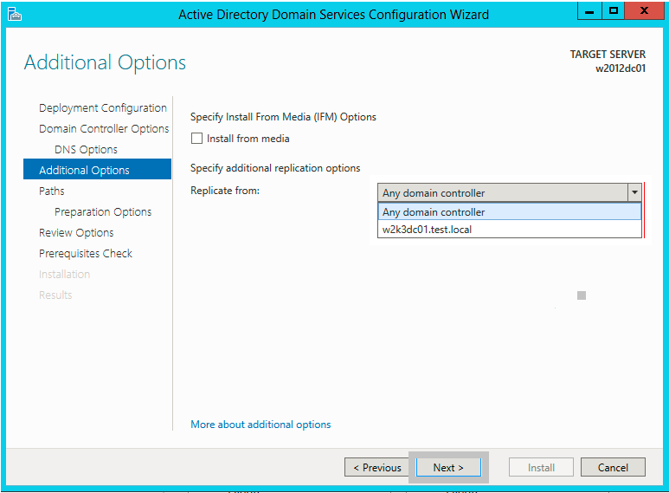
Step-3: Promote Azure VM as Additional DC

Slide 24
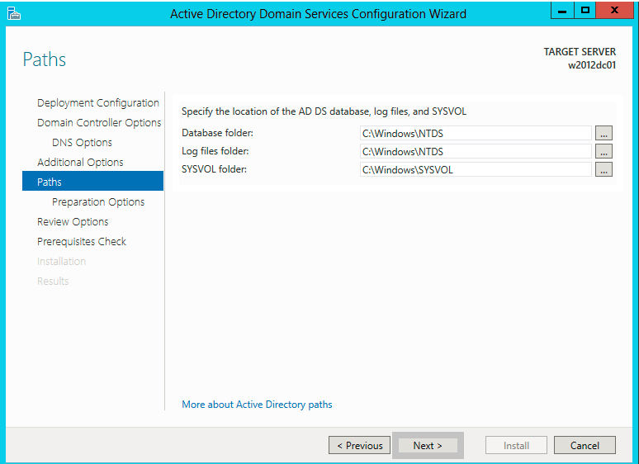
Step-3: Promote Azure VM as Additional DC

Slide 25
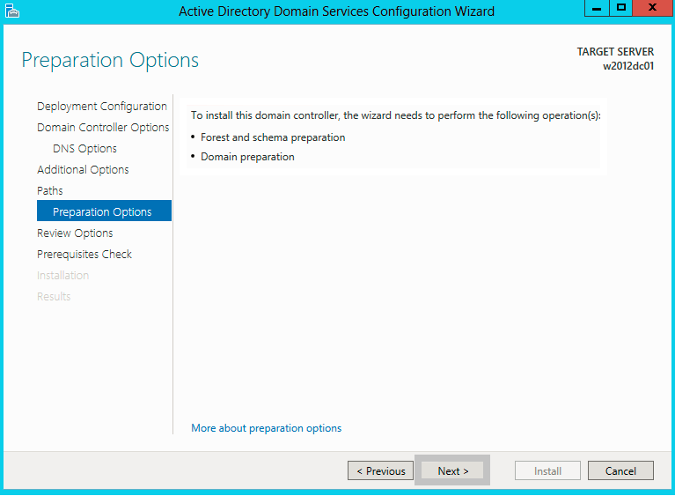
Step-3: Promote Azure VM as Additional DC

Slide 26
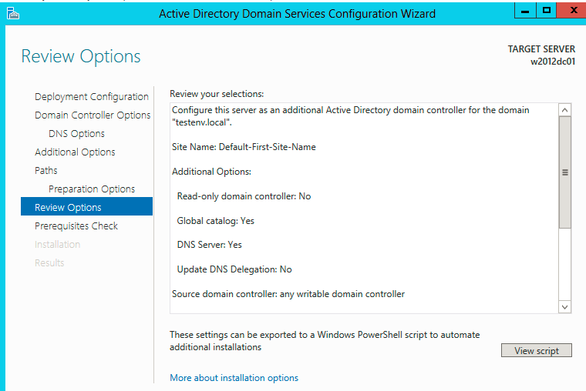
Step-3: Promote Azure VM as Additional DC

Slide 27
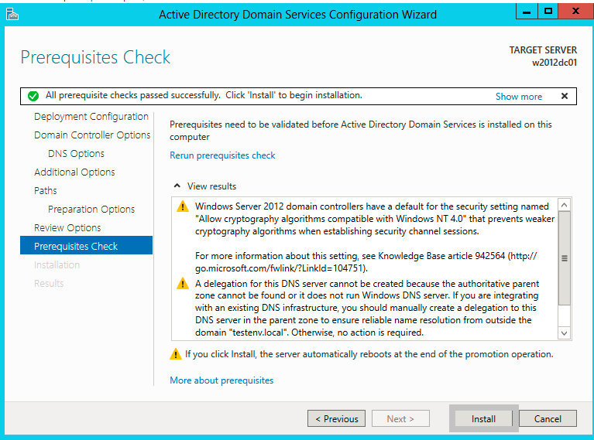
Step-3: Promote Azure VM as Additional DC

